Slide 1
Health Related Training
Stock Meds,
Stop the Bleed, Hands-Only CPR
Carl Junction R-1 Schools

Slide 2
Agenda
Review of these topics and hands-on practice. This is not in-depth information, only the quick basics of what you will need to know to respond to an emergency until help arrives.
1) Epipen use and return demonstration. (required for district employees) (Epipen kept in CJU office side closet.)
2) Seizure video and assessment (completed on your own). Use sign off sheet if you were unable to turn in certification of completion. (required for district employees). This is completed on Vector.
Bonus training:
3) Asthma inhaler and demonstration. (In school nurse office. Know the location for your building.)
4) Narcan use and return demonstration. (In school nurse office. Know the location for your building.)
5) Stop the Bleed Quick training
-tourniquet use,
-applying pressure to a wound
-packing a wound and you will get a chance to practice.
7) Conscious choking- Adult and Child
8) Hands-only CPR
9) Q & A

Slide 3
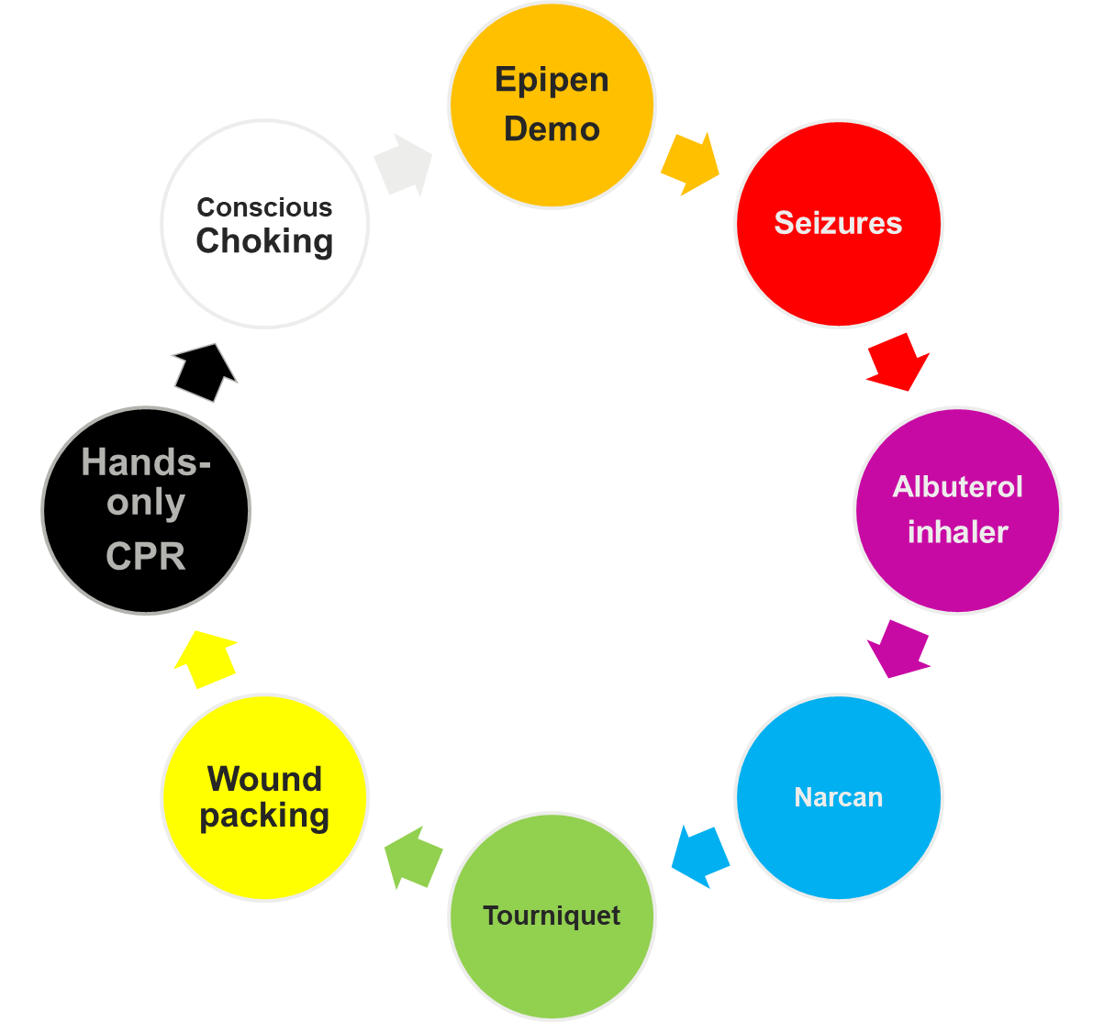
REVIEW AND PRACTICE
Hands-only CPR
Conscious Choking

Slide 4
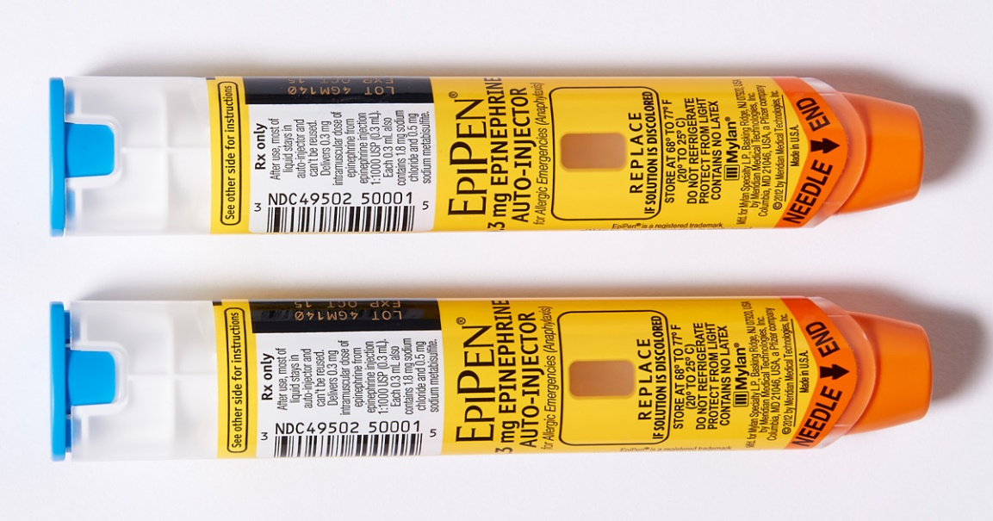
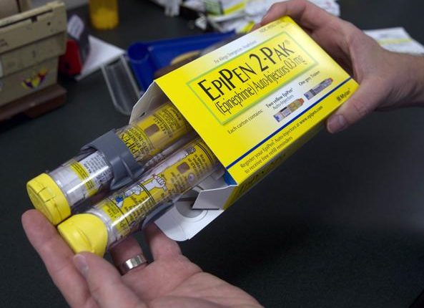
EPIPEN
HOW TO USE AN EPIPEN
Blue end up
Orange end down
“Blue to the sky, orange to the thigh”
Push and hold in place, count to 10 (we count fast in emergencies)
Call 911

Slide 5
EPIPEN
DISTRICT POLICY JHCF STUDENT ALLERGY PREVENTION AND RESPONSE

Slide 6

Epipen video link

Slide 7
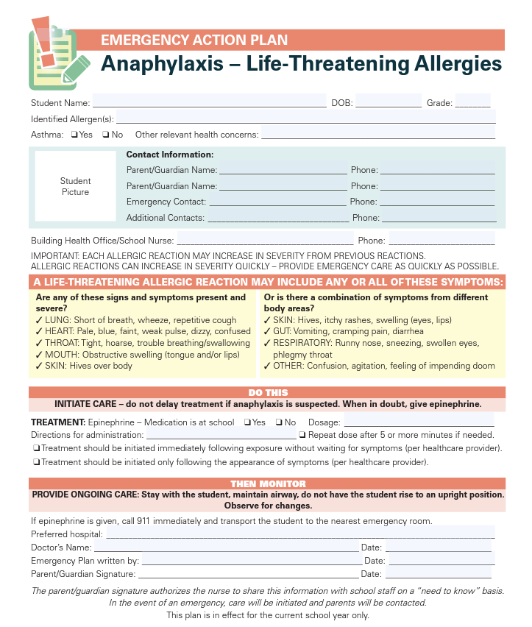
EPIPEN

Slide 8
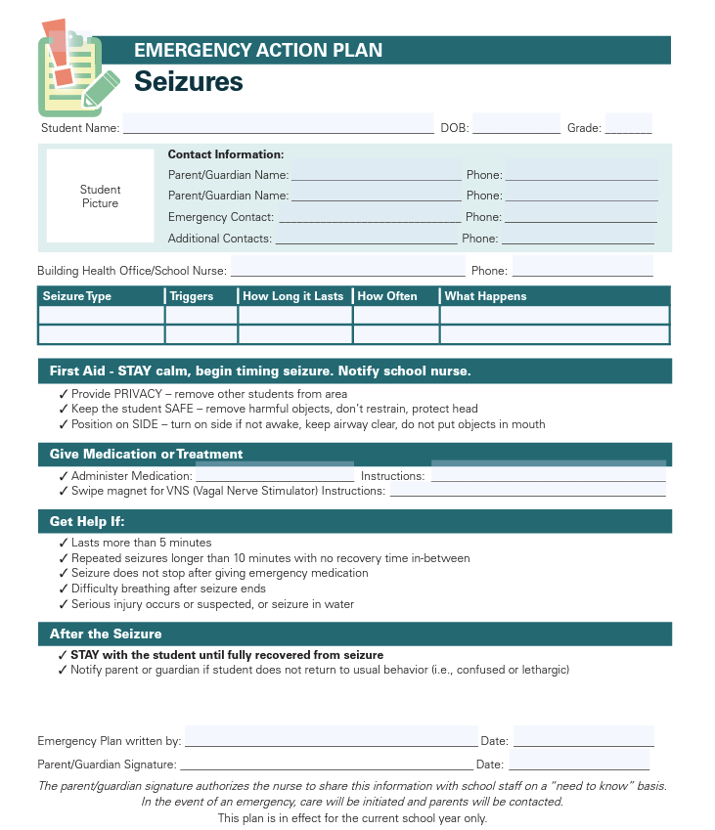
SEIZURES IN SCHOOLS
SEIZURE TRAINING FOR SCHOOL PERSONNEL
Link to assessment and certification of completion

Slide 9
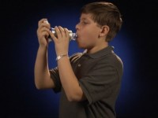
Albuterol Inhaler
Use if student is showing signs of breathing difficulty:
Nasal flaring, increased respiratory rate, wheezing or other abnormal breathing sounds, abnormal skin color AND their own inhaler is not available
Then use the school stock albuterol
After use, observe the student until improved. If not improved, call the parent and 911 if necessary.
How to use an inhaler video link

Slide 10
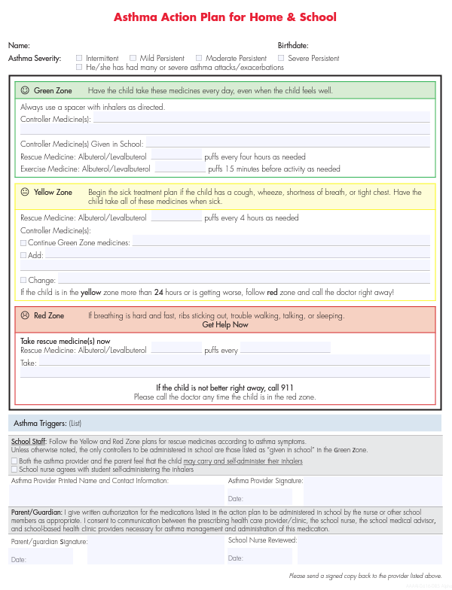
Asthma Action Plan

Slide 11
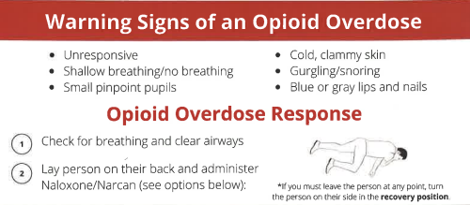
Narcan
Narcan should only be used for overdose symptoms, not for individuals experiencing an opioid high. If you are unsure whether the person has used an opioid, using Narcan is safe and will not harm them.

Slide 12
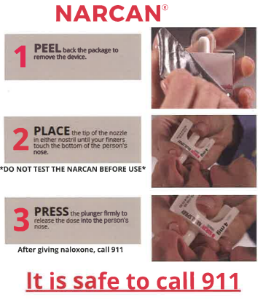

Slide 13
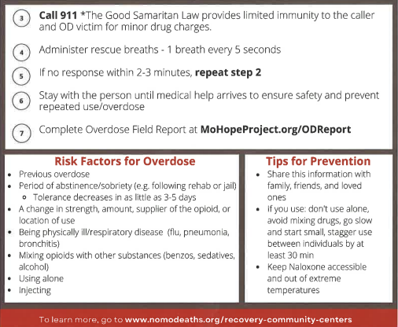
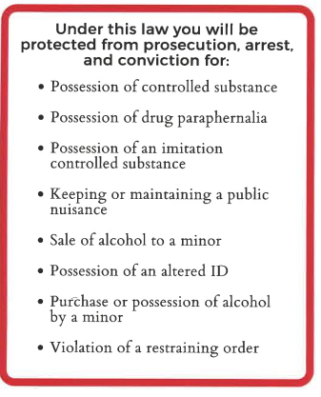

Slide 14
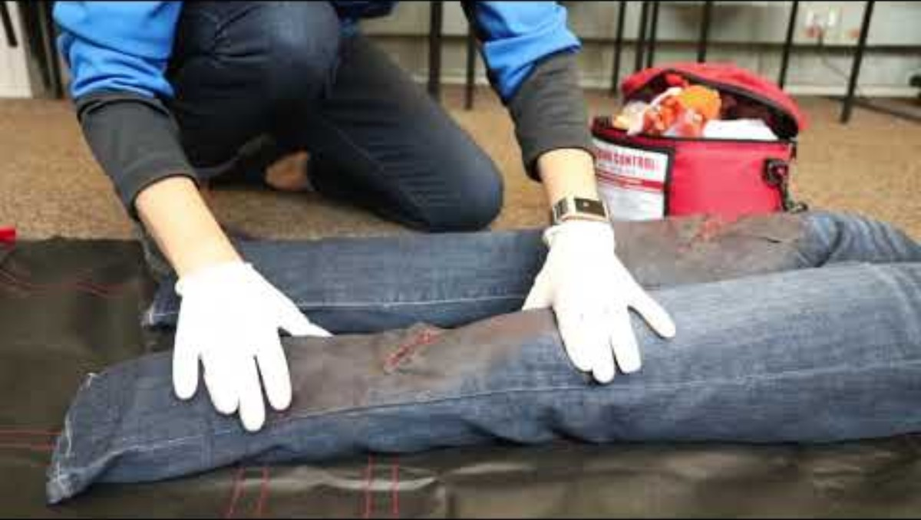
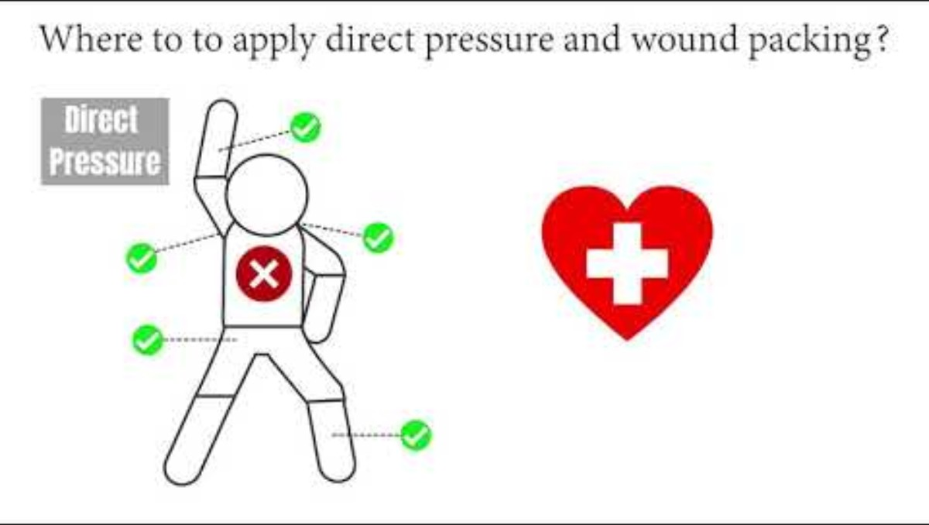
Applying a Tourniquet
Applying Pressure and Wound Packing
How to apply a tourniquet video link
Applying pressure and wound packing video link

Slide 15
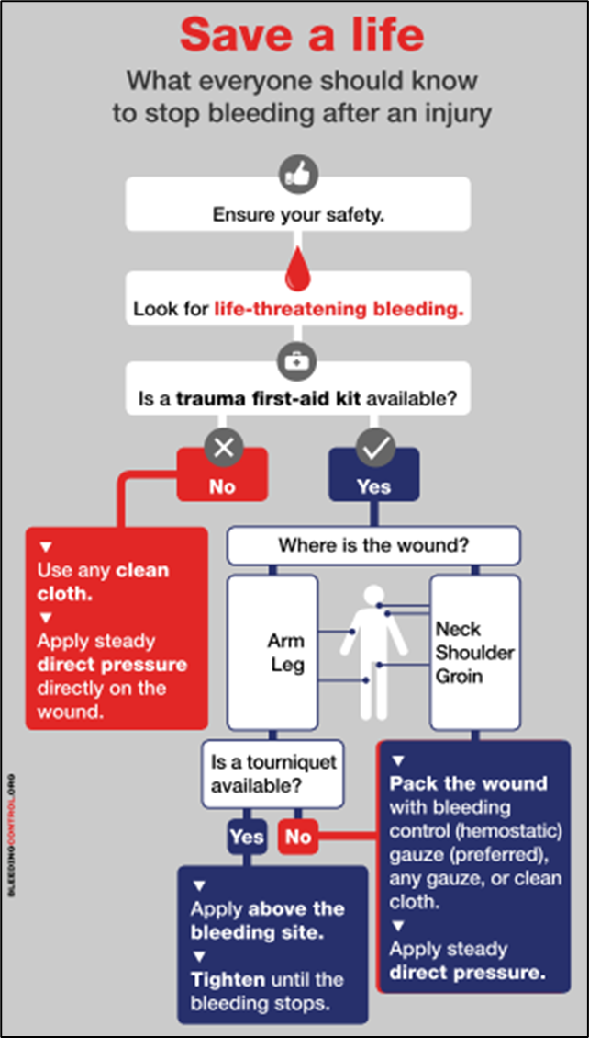
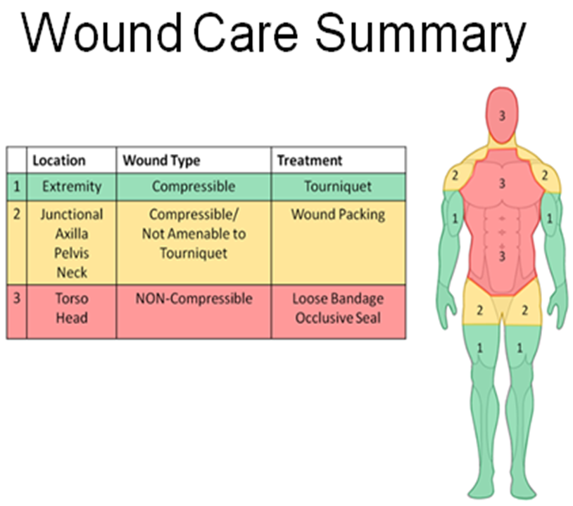
Stop the Bleed Kit
And Practice

Slide 16
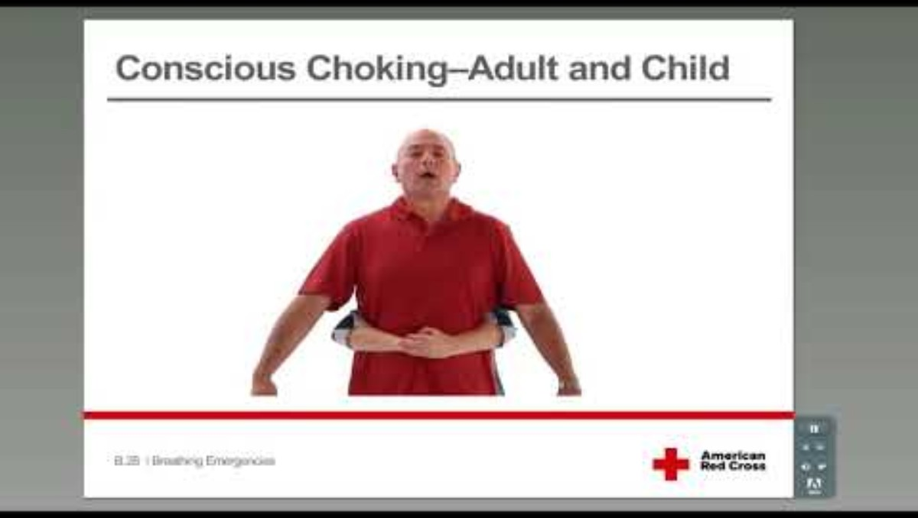
Conscious Choking
Conscious Choking Video- Adult and Child

Slide 17
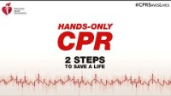
HANDS ONLY CPR
Hands-only CPR link

Slide 18
Questions?? Feedback??
Amberlee Miller, BSN, RN
Phone 417-649-5719
Cell 417-438-3659
amiller@cjr1.org
Thank you for being a captive audience!!

